Slide 1


Mindcare
AI
A Path to Well-being
Team Name -Techno bytes
Team Member :-
Aditya Sinha (solo)

Slide 2

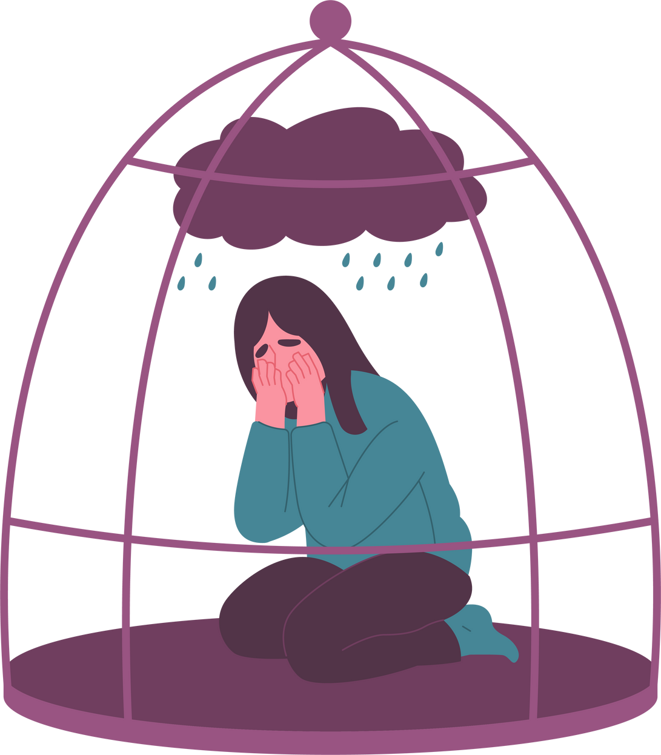
Problem
Statement
Rising Mental Health Crisis: Depression and anxiety affect 1 in 4 people globally.
Access Barriers: Long wait times, high therapy costs, social stigma.
Lack of Scalable Emotional Support: Many suffer in silence without real-time help.
Youth & Students Affected: Increasing emotional stress with limited support.

Slide 3


Solution -
Mindcare AI
AI-Powered Mental Wellness Platform
24/7 Emotional Support via Chatbot
Mood Tracking & AI Feedback
Self-Care Exercises & Coping Tools
Crisis Detection with Human Backup
A private, scalable, always-available mental health companion.

Slide 4

Features
📊 AI Mood
Tracking &
Sentiment
Feedback
🧘 Guided Meditation, Journaling, Breathing
✨ AI Chatbot for Real-time Emotional Support
✨ Blockchain integrated in chats
⚠️ Crisis Detection + Emergency Help
🌍 Multilingual + Voice Input Support
🎧 Music Therapy & Gratitude Wall
🔁 Human-in-the-Loop for Critical Safety

Slide 5


HOW IT WORKS
User signs in → interacts with AI chatbot
Daily check-ins analyze emotional state
Personalized resources + coping strategies suggested
AI detects signs of crisis → connects to real help if needed
Data visualized through dashboards (emotion trends, progress)

Slide 6
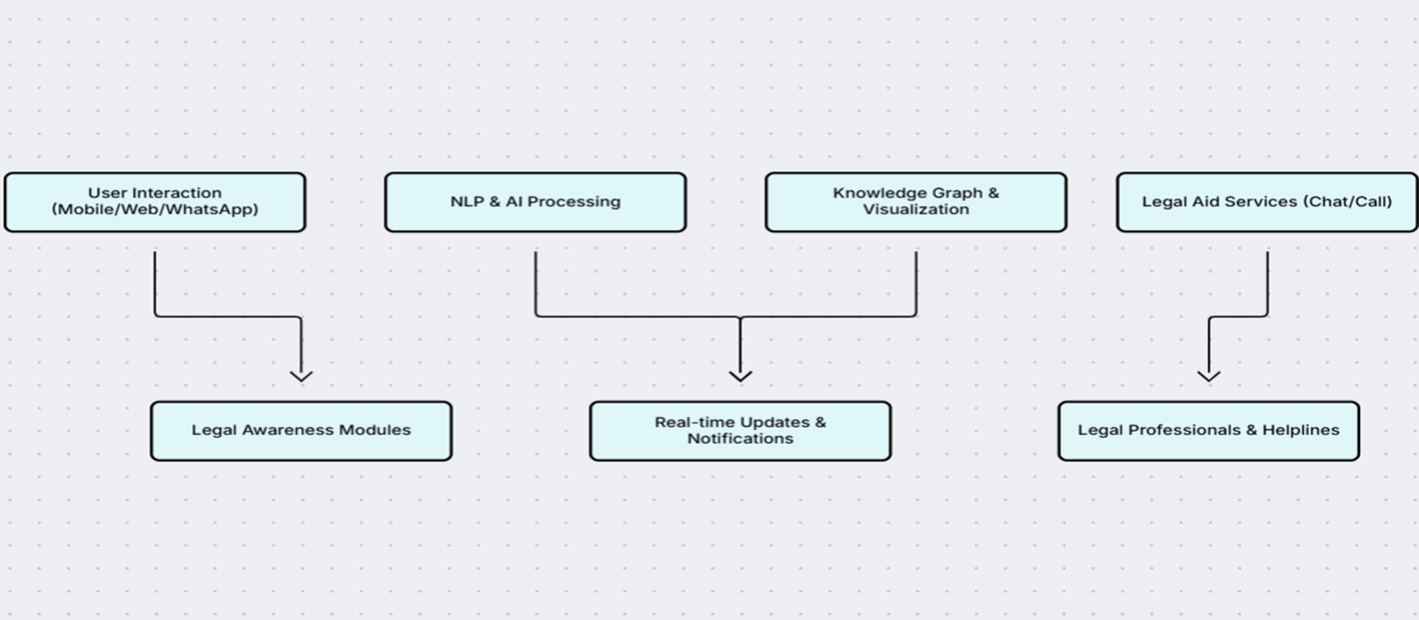
ARCHITECHTURE
A LANDING PAGE OF OUR WEB APP
https://v0-new-project-hznaw26h46c.vercel.app/

Slide 7


TECH STACK
Frontend: React, Tailwind CSS
AI/ML: Gemini GPT , TensorFlow (for mood detection)
Backend: Supabase Auth, Supabase DB, Cloud Functions
APIs: YouTube API for music
Design: Figma, Webflow (for UI/UX prototyping)

Slide 8


USP MSP
24/7 anonymous, emotionally intelligent support
Democratizing mental health care for youth, students, and underserved communities
AI + Human hybrid care model for safety & trust
Bridging the access gap using ethical, affordable AI tools
Calm, gamified user experience built for all ages

Slide 9

BUSINESS MARKET
MODEL STRATEGY
Freemium Tier: Free AI chat, journaling, mood tracking
🎓 Campus Ambassador Program (target students)
Premium Tier ($): Advanced mood analytics, therapist access, custom AI wellness plans
🤝 Partnerships with NGOs & Edu Platforms
B2B SaaS: Licensing to colleges, HR departments, wellness apps
📱 Social Media & Influencer Awareness Campaigns
CSR Partnerships: For impact-based deployments with NGOs
🧪 Freemium Model for fast onboarding

Slide 10

🌍 Making mental health support universally accessible
Thank You
🤖 Building emotionally aware, ethical AI

